Slide 1
FriendsPsuedoNet :
Generating Labels through Cooperation
Presenter : Hyeonsoo Lee
High-performance Visual Computing Laboratory Ulsan National Institute of Science and Technology hvcl.unist.ac.kr
08/21/2019

Slide 2

Introduction
Motivation
How to study in exam period?
Study Alone?
Emoji from ‘공부하다 미친 댕댕이’ kakao

Slide 3

Introduction
Motivation
How to study in exam period?
Study Alone?
Study with a friend!
Emoji from ‘공부하다 미친 댕댕이’, kakao

Slide 4

Introduction
Motivation
How to study in exam period?
When we discuss with a friend, We notice something we missed!
Study with a friend!
Emoji from ‘공부하다 미친 댕댕이’, kakao

Slide 5
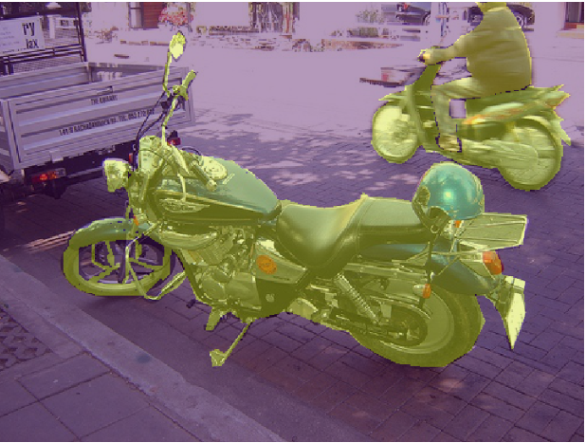
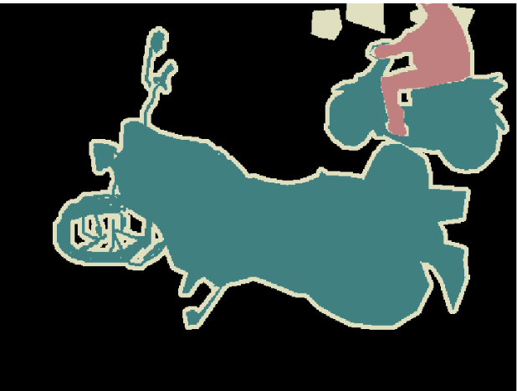
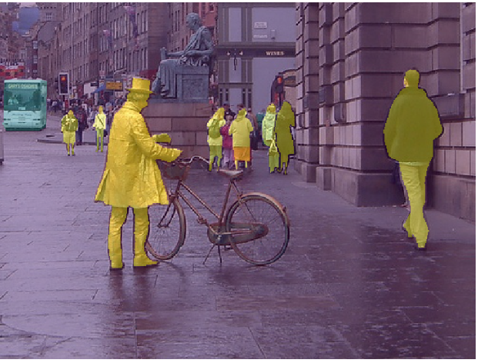
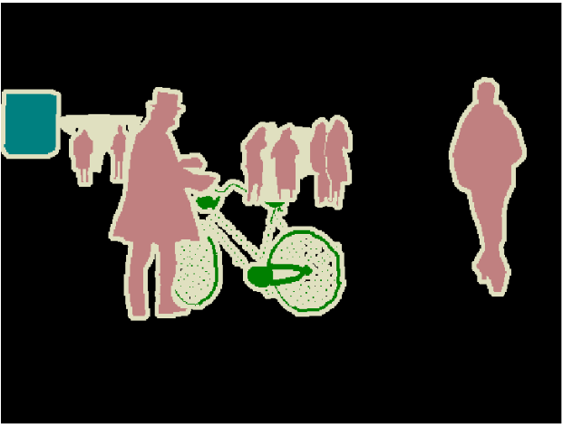
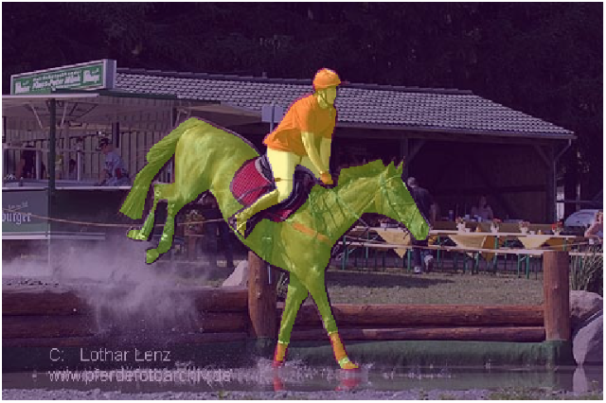

Introduction
Motivation
Pascal VOC 2012
1~20 : 20 Classes
0 : Background
255: Border or Unlabeled
Problem
Too many un-labels !

Slide 6
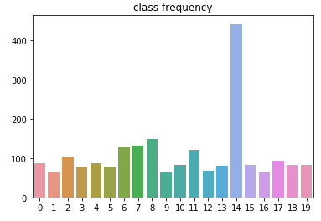
Introduction
Motivation
Pascal VOC 2012
1~20 : 20 Classes
0 : Background
255: Border or Unlabeled
Problem
Too many un-labels !

Slide 7
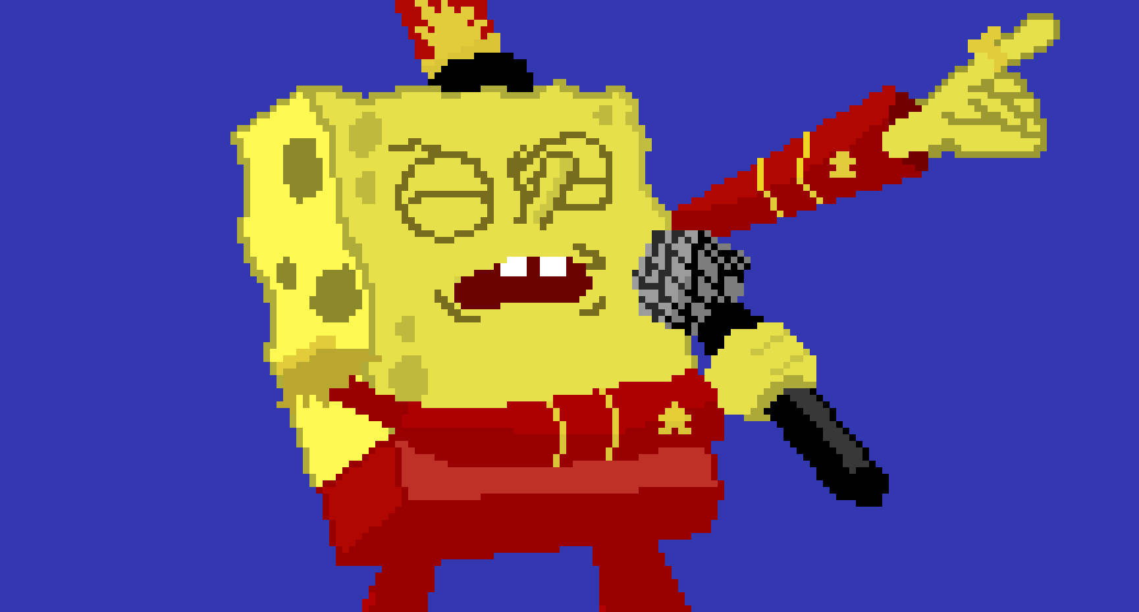
Introduction
Motivation
Make Pixels Great Again!!

Slide 8
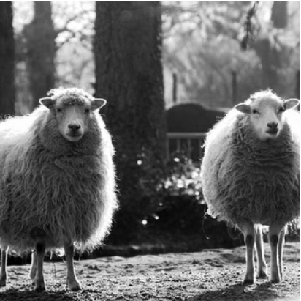
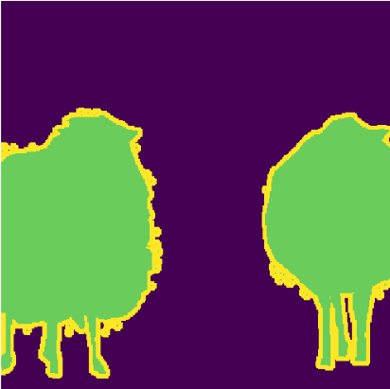
Introduction
Motivation
May we can make a label for unlabeled area?
Image
Mask

Slide 9
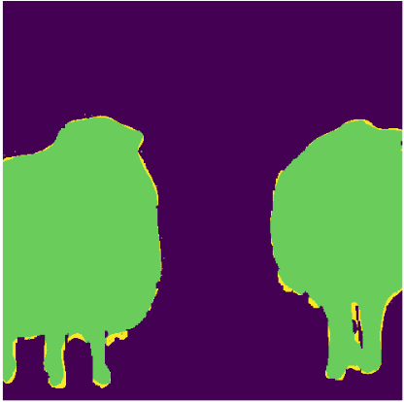
Introduction
Motivation
May we can make a label for unlabeled area?
Image
Mask
Modified Mask

Slide 10
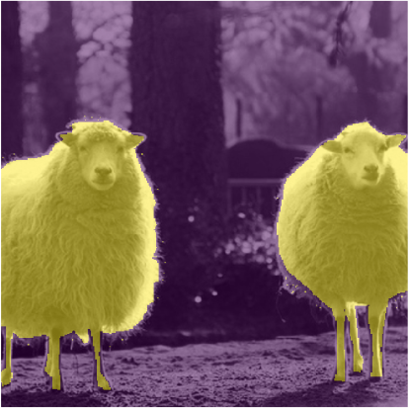
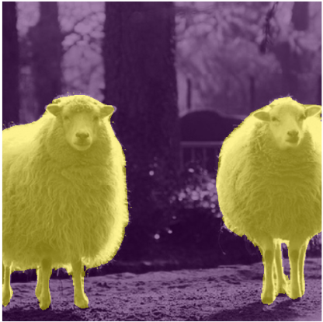
Introduction
Motivation
May we can make a label for unlabeled area?
Image
Mask
Modified Mask

Slide 11
Introduction
Motivation
May we can make a label for unlabeled area?
Image
Mask
Modified Mask

Slide 12
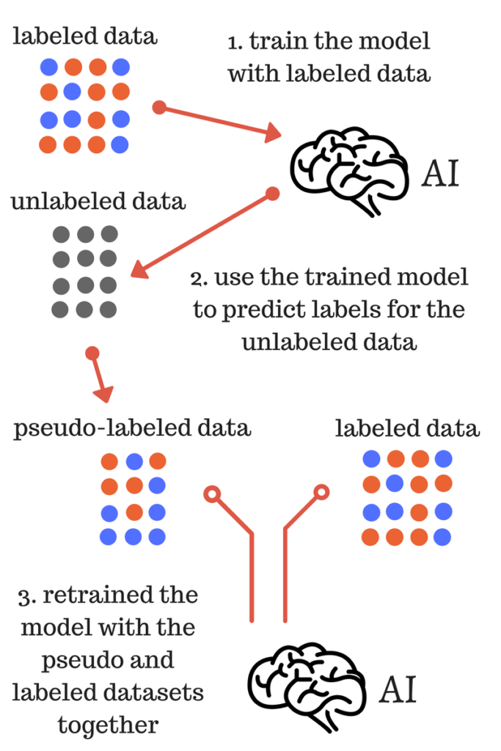
Introduction
Related Work – semi-supervised learning
Pseudo Labeling (ICML, 2013)
<Step1>
Pre-trained Network generates labels for unlabeled data
<Step2>
Using generated labels, re-train the network.

Slide 13
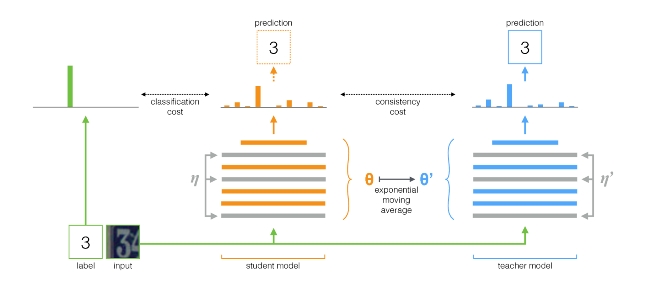
Introduction
Related Work – semi-supervised learning
Mean teachers (NIPS, 2017)
Generates labels for unlabeled data during training stage.
Generated labels are unstable, so it uses exponential moving average for parameters

Slide 14
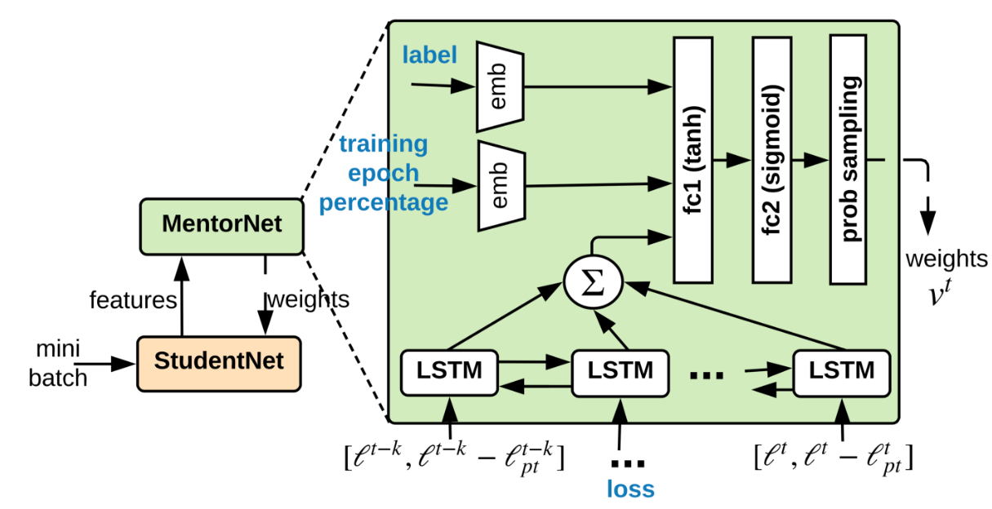
Introduction
Related Work – learning with noisy label
MentorNet (ICML, 2018)
There is a mentor who teaches which label is wrong.

Slide 15


Method
FriendsPseudoNet
Some pixels seem missed
I agree
MODEL 1
MODEL 2

Slide 16


Method
FriendsPseudoNet
MODEL 1
MODEL 2

Slide 17
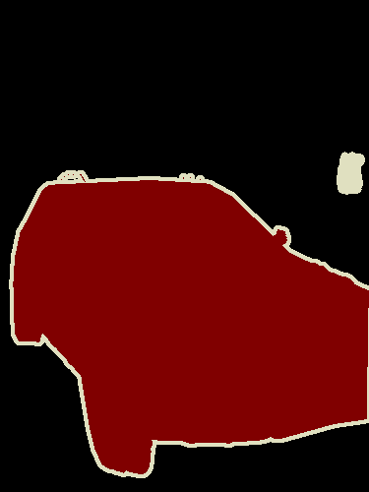
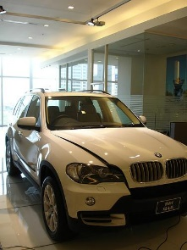



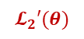
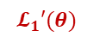
Method
FriendsPseudoNet
Ground Truth
$$𝓛_{1}′(θ)$$
Input
Modified Mask
$$𝓛_{2}′(θ)$$
Input
: Pseudo Mask Generation

Slide 18
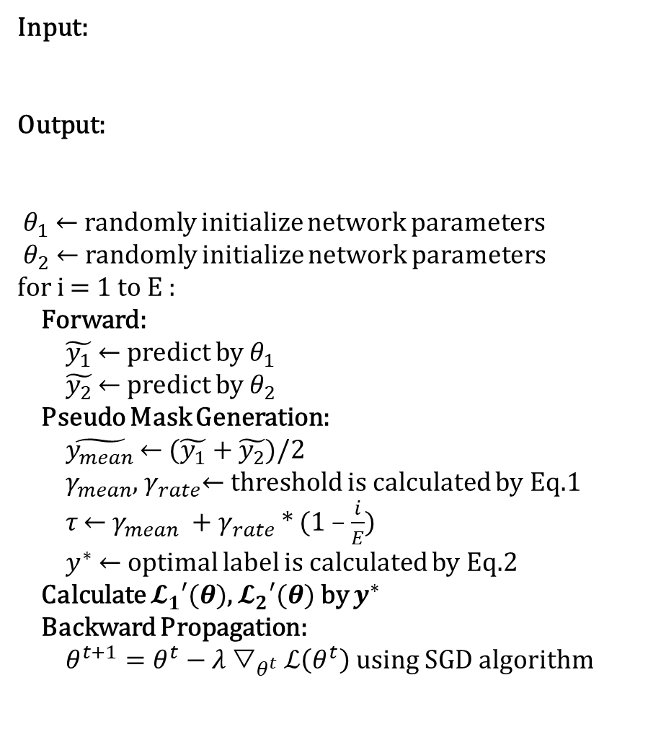
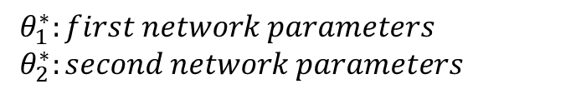
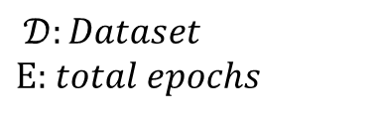
Method
Input:
Output:
$θ_{1}$ ← randomly initialize network parameters
$θ_{2}$ ← randomly initialize network parameters
for i = 1 to $Ε$ :
Forward:
$\tilde{y_{1}}$ ← predict by $θ_{1}$
$\tilde{y_{2}}$ ← predict by $θ_{2}$
Pseudo Mask Generation:
$\tilde{y_{mean}}$ ← ($\tilde{y_{1}}$ + $\tilde{y_{2}}$)/2
$γ_{mean}$, $γ_{rate}$← threshold is calculated by Eq.1
𝜏 ← $γ_{mean}$ + $γ_{rate}$* (1 – $\frac{i}{E}$)
$y^{∗}$ ← optimal label is calculated by Eq.2
Calculate $𝓛_{1}′(θ)$, $𝓛_{2}′(θ)$ by $y^{∗}$
Backward Propagation:
$θ^{t+1}=θ^{t}−λ▽_{θ^{t}}ℒ\left(θ^{t}\right)$ using SGD algorithm
$𝒟:Dataset$
$Ε$: $total epochs$
FriendsPseudoNet
$θ_{1}^{∗}:first network parameters$
$θ_{2}^{∗}:second network parameters$

Slide 19
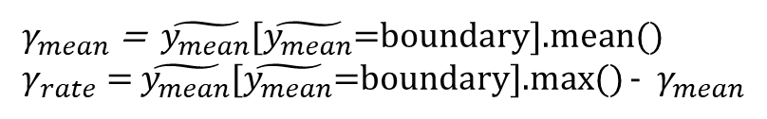
Method
FriendsPseudoNet
$γ_{mean}$ = $\tilde{y_{mean}}$[$\tilde{y_{mean}}$=boundary].mean()
$γ_{rate}$ = $\tilde{y_{mean}}$[$\tilde{y_{mean}}$=boundary].max() - $γ_{mean}$
(Eq.1)
$y^{∗}$= boundary & $(\tilde{y_{mean}}>\text{τ}\text{)}$ & ($\tilde{y_{1}}∩\tilde{y_{2}}$) : else ? $\tilde{y_{1}}$ : $y$
(Eq.2)

Slide 20
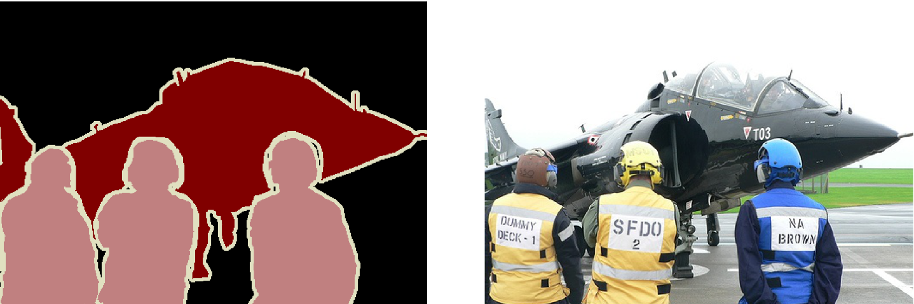
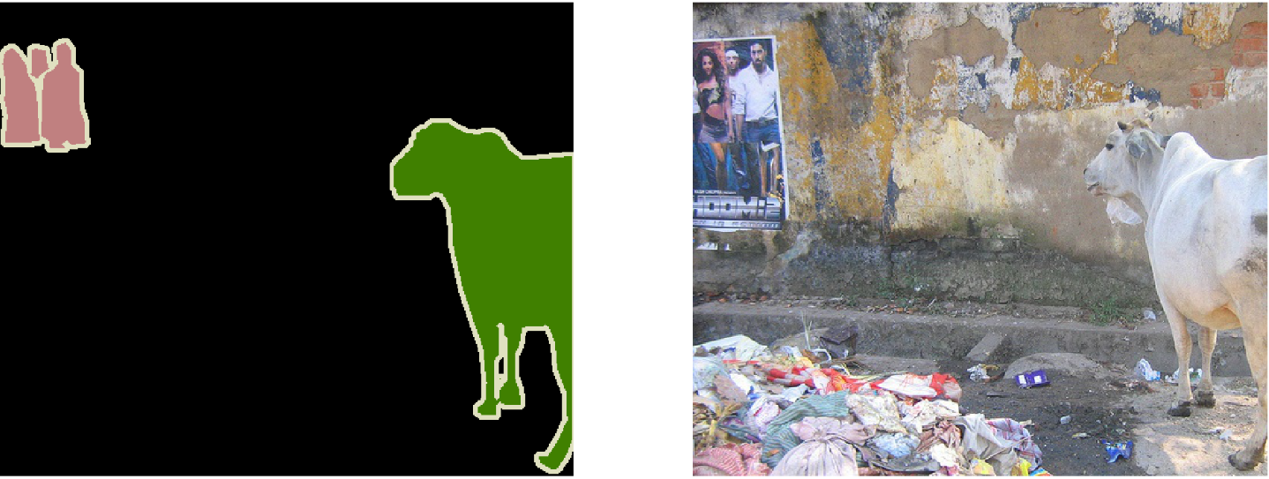
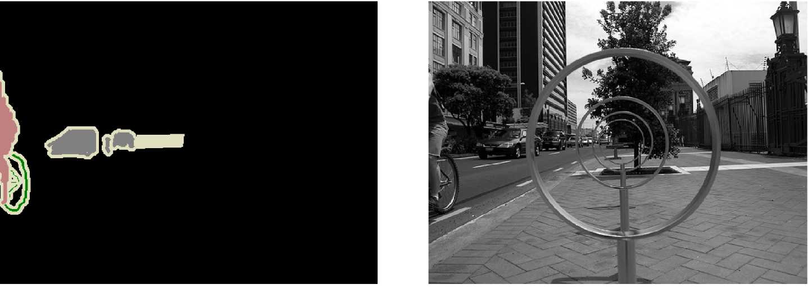
Experiment
Dataset & Training Info
PASCAL VOC 2012 Segmentation
Train: 1464 images
Test: 1449 images
1~20 : 20 Classes
0 : Background
255: Border or Unlabeled

Slide 21
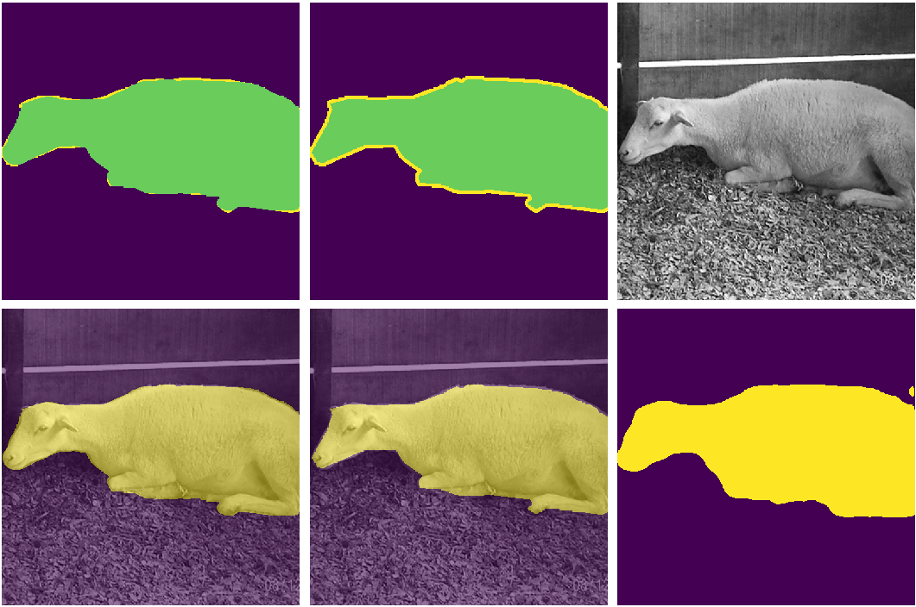
Experiment
Model1: DeepLab-v3+ (resnet101)
Model2: DeepLab-v3+ (drn-d-54)
Motivation
Modified Mask
Mask
Image
Shape maintains,
Unnecessary pixels remove
M-mask Overlap
Mask Overlap
Prediction1

Slide 22
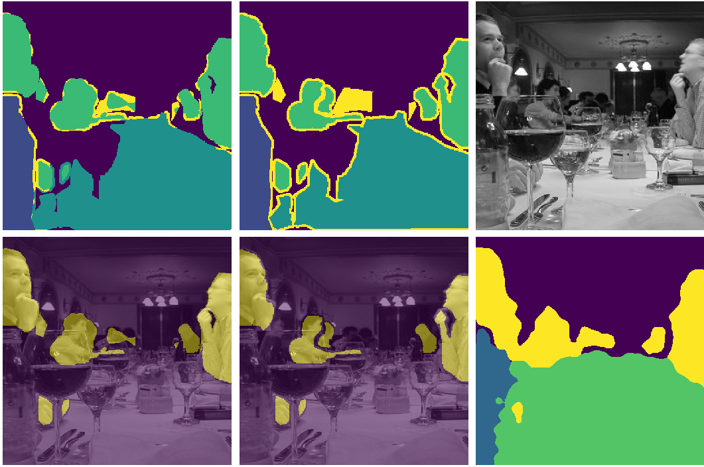
Experiment
Model1: DeepLab-v3+ (resnet101)
Model2: DeepLab-v3+ (drn-d-54)
Motivation
Modified Mask
Mask
Image
Multiple Objects,
Find more people in the image
M-mask Overlap
Mask Overlap
Prediction1

Slide 23
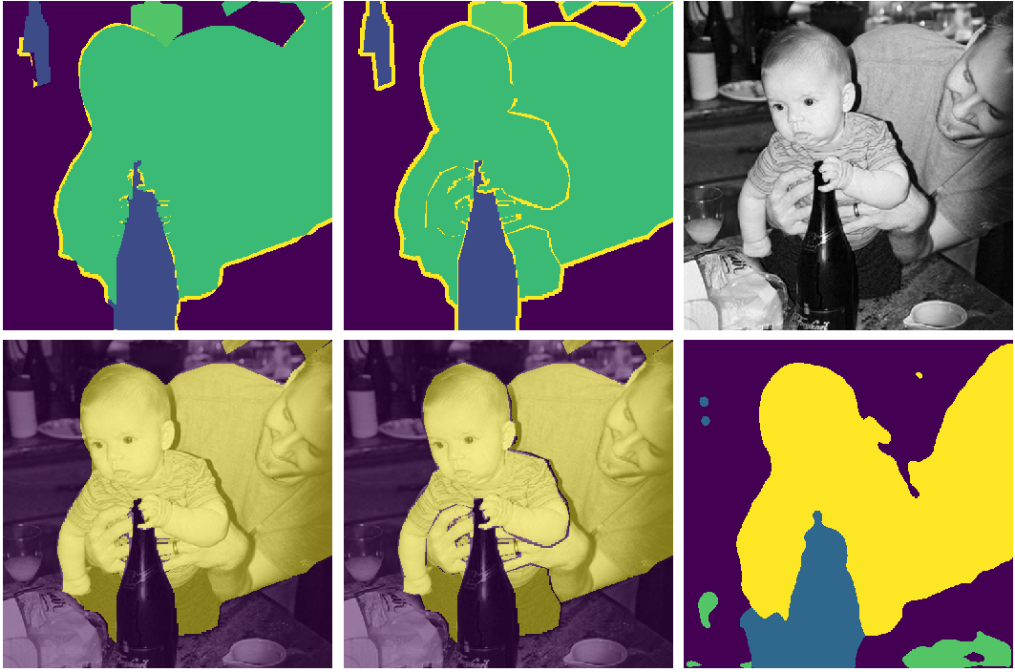
Experiment
Model1: DeepLab-v3+ (resnet101)
Model2: DeepLab-v3+ (drn-d-54)
Motivation
Modified Mask
Mask
Image
Unnecessary pixels remove
M-mask Overlap
Mask Overlap
Prediction1

Slide 24
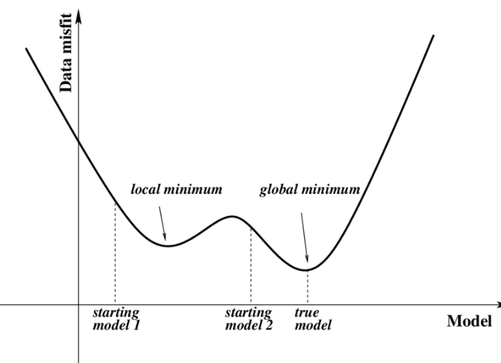
Experiment
Dataset & Training Info
FriendsPseudoNet
Preprocessing
HorizontalFlip
RandomScaleCrop
RandomGaussianBlur
Normalization
Training Strategy
Optmizier: SGD
Scheduler: CosineAnnealing
Model1: Deeplab-v3+ (resnet101)
Model2: Deeplab-v3+ (resnet101)
lr (backbone) : 0.003
lr (ASAP, Decoder): 0.03
Gradient Accumulation: None
Batch Size: 8
Epoch: 100
Machine Info
TITAN V (12G) x 2

Slide 25
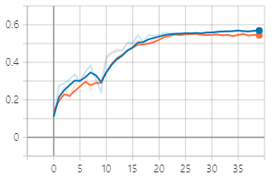
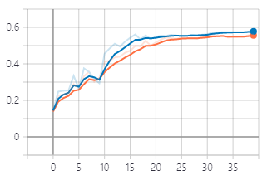
Experiment
FriendsPseudoNet
Failed on optimizing two models simultaneously (Implementation Failure)
MIoU (Blue: baseline, Orange: FriendsPseudoNet)
Best: 0.578
Best: 0.556
Single Model Best MIoU: 0.7279

Slide 26

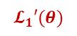
Method
PseudoNet
Ground Truth
Input
$$𝓛_{1}′(θ)$$
Modified Mask

Slide 27
Experiment
PseudoNet
Preprocessing
HorizontalFlip
RandomScaleCrop
RandomGaussianBlur
Normalization
Training Strategy
Optmizier: SGD
Scheduler: ReduceLROnPlateau
Model1: Deeplab-v3+ (resnet101)
Model2: Deeplab-v3+ (resnet101)
lr (backbone) : 0.003
lr (ASAP, Decoder): 0.03
Gradient Accumulation: 2
Batch Size: 8
Epoch: 100
Machine Info
TITAN V (12G) - PseudoNet
RTX 2080 TITAN (24G) - baseline

Slide 28
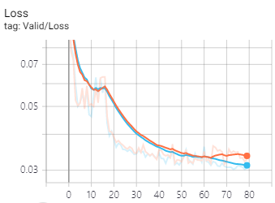
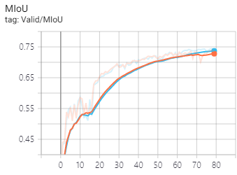
Experiment
PseudoNet
PseudoNet (Modify by confidence of a model)
MIoU (Blue: baseline, Orange: PseudoNet)
Best: 0.7279
Best: 0.7440

Slide 29
Conclusion
FriendsPseudoNet
Conclusion
Propose self-generating mask algorithm
Prove that self-generating mask improves the segmentation result
Reduce human’s annotation cost
Future Work
It can be extensible to different dataset by making ambiguous pixels of un-labeled Or, We can generate un-labeled class during training stage (Combating Label Noise in Deep Learning Using Abstention, ICML 2019)
It can be extensible to any task (classification, segmentation, …)

